Slide 1
Sales Performance Report
2013-2014
Presented by
Vishwa

Slide 2
Agenda
Key Highlights
Overall KPIs
Country-Level Sales
Segment Performance
Product Insights
Discount Impact
Monthly Trends
Financial Analysis (Sales vs COGS vs Profit)
Insights
Recommendations

Slide 3
Executive Summary
Total sales reached $16.89M across 2013–2014.
Total profit is also $16.89M, indicating highly profitable products.
Total units sold: 1.12M units
Highest revenue-generating country: USA (~$2.50M)
Strongest segment: Midmarket (44% contribution)
Discounts significantly impact sales, especially in the Low and Medium bands.
Sales peak in October & November.
Top product by sales: Paseo (≈ $3.3M)

Slide 4
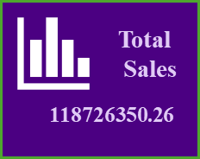

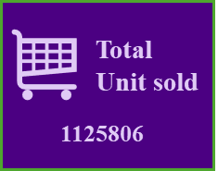
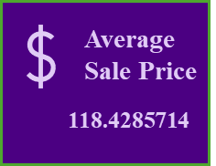
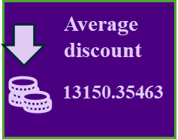
Overall KPIs
Total Sales: 16,893,702.26
Total Sales: 118726350.26
Total Profit: 16,893,702.26
Total units sold: 1.12M units
Average sale: 118.43
Average Discount: 13,150.35

Slide 5
Sales by Country
Country | Sales
USA | 25,028,830.17
Mexico | 24,887,654.89
Germany | 23,505,340.82
France | 24,354,172.28
Canada | 20,949,352.11
Key Insight
USA leads with $25M, followed closely by Mexico and France.
Canada has the lowest sales among the five countries.

Slide 6
Segment-wise Sales & Profit
Midmarket → 44%
Government → 36%
Enterprise → 17%
Channel Partners → 1%
Small Business → 2%
Key Insight
Midmarket + Government together generate 80%+ of revenue.

Slide 7
Discount Band Impact
Low Discount → $6,188,857
Medium → $5,575,222
High → $3,388,866
None → $1,736,455
Interpretation:
Lower discount bands drive maximum sales volume.
High discounts reduce profitability.

Slide 8
Monthly Sales Trend
(2013 vs 2014)
2013
Stable sales around $4M–$8M per month
Slight drop in June
Peak in December
2014
Higher volatility
Massive peak in October (Top performing month)
Decline in Nov–Dec.
Interpretation:
Sales exhibit clear Q4 seasonality, especially in 2014.

Slide 9
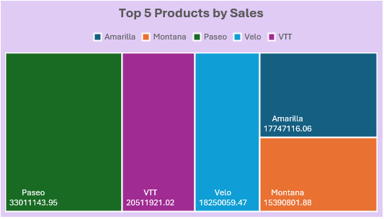
Top 5 Products by Sales
Paseo $3.30M
VTT $2.05M
Velo $1.83M
Amarilla
$1.77M
Montana $1.53M
Interpretation:
Sales exhibit clear Q4 seasonality, especially in 2014.

Slide 10
Sales vs COGS vs Profit
2013
Sales: ~$9.23M
COGS: ~ $2.25M
Profit: ~ $7.97M
2014
Sales: ~ $7.92M
COGS: ~ $2.64M
Profit: ~ $5.37M
Insight
2013 generated higher profit than 2014, despite similar sales volumes.

Slide 11
Insight
USA is the highest contributing country.
Midmarket is the strongest performing segment
Paseo is the top-selling product
Low & Medium discounts create maximum sales
Sales improve heavily during October–December
2013 had stronger profitability than 2014

Slide 12
Insight
Boost inventory for top products (Paseo, VTT, Velo) in peak months.
Target Midmarket & Government segments with marketing campaigns.
Optimize discount strategy—reduce high discounts.
Focus on Canada to improve its performance.
Investigate profit drop in 2014 to correct cost structure.

Slide 13
THANK YOU

